Slide 1

Early diagnosis of Asthma using the Patient and health records
MIS 7620- M50
RAJA SUMANTH REDDY ARRAM
VAMSIDHAR REDDY JANNAPALLY
SHRESTA CHAPALA
LAKSHMI SUMITH KUMAR KEERTHIPATI

Slide 2
INTRODUCTION
PROBLEM STATEMENT: Asthma is a chronic respiratory disease affecting millions of people of all ages across the globe. Unfortunately, there is no particular data models in the healthcare system to predict this common yet serious disease in advance due to the lack of patient data and even if data is available, there are no supportive resources to handle and present the data in a format that can be used by doctors or medical professionals to detect the Asthma at the earlier stages or even better, they can predict one. The challenge is to leverage the technological advances using machine learning within healthcare domain to enhance early detection and predictions there by hospitals, doctors and patients can anticipate the asthma attack be emergency ready, which improves emergency room visits and overall patient well-being and health in long term and also helps in tailoring the patient focused treatment plans.

Slide 3


DATASETS
Asthma DataSet for Early Prediction(Cleaned Data)
This data set provided is a collection of health records and patient data curated for research and modelling purposes. This data contains the, age groups, severity and treat outcomes of the patients which provides us with the valuable insights across all ages different conditions and helps us in a great predictive analysis, enhancing early detection, management and overall efficient patient care.
Metadata: Presence of asthma, Health related issues and Age.

Slide 4



Data Preprocessing
The actual data is from time periods 2020 to 2022 across all stated in USA. However, this data is not sufficient for us to conduct the analysis and visualizations, so we choose to remodel the data, format it and perform certain data cleaning activities which were mentioned in the next slide.

Slide 5

We implemented the following ways to clean the data
Downloaded Source Data Set from Kaggle.
Checked for NULL values and removed them
Made the data arranged in the required order
Formatted the Data in Excel
Converted it from CSV to .xlsx for better on-boarding into Tableau
Made from conversions wherever required and stored the calculated fields.

Slide 6
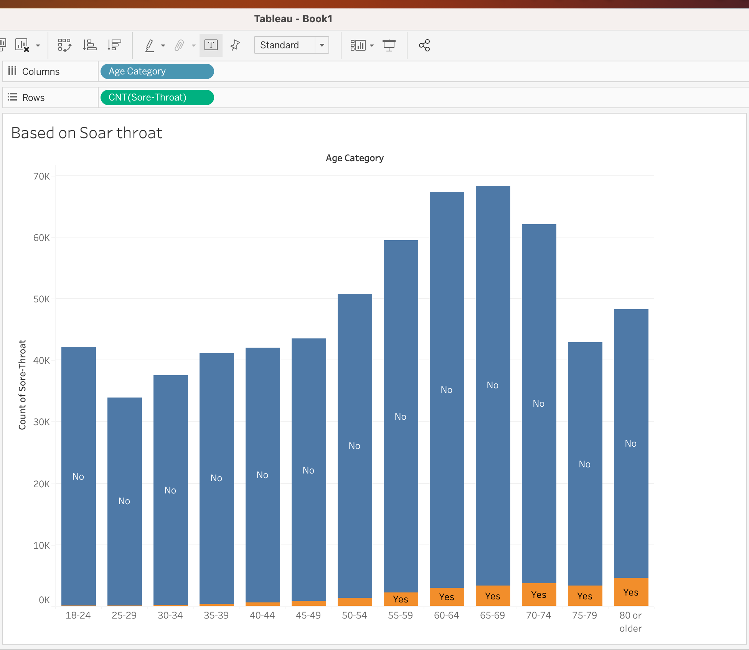
The above graph shows people who are prone to asthma at various ages who has soar throat as common symptom

Slide 7
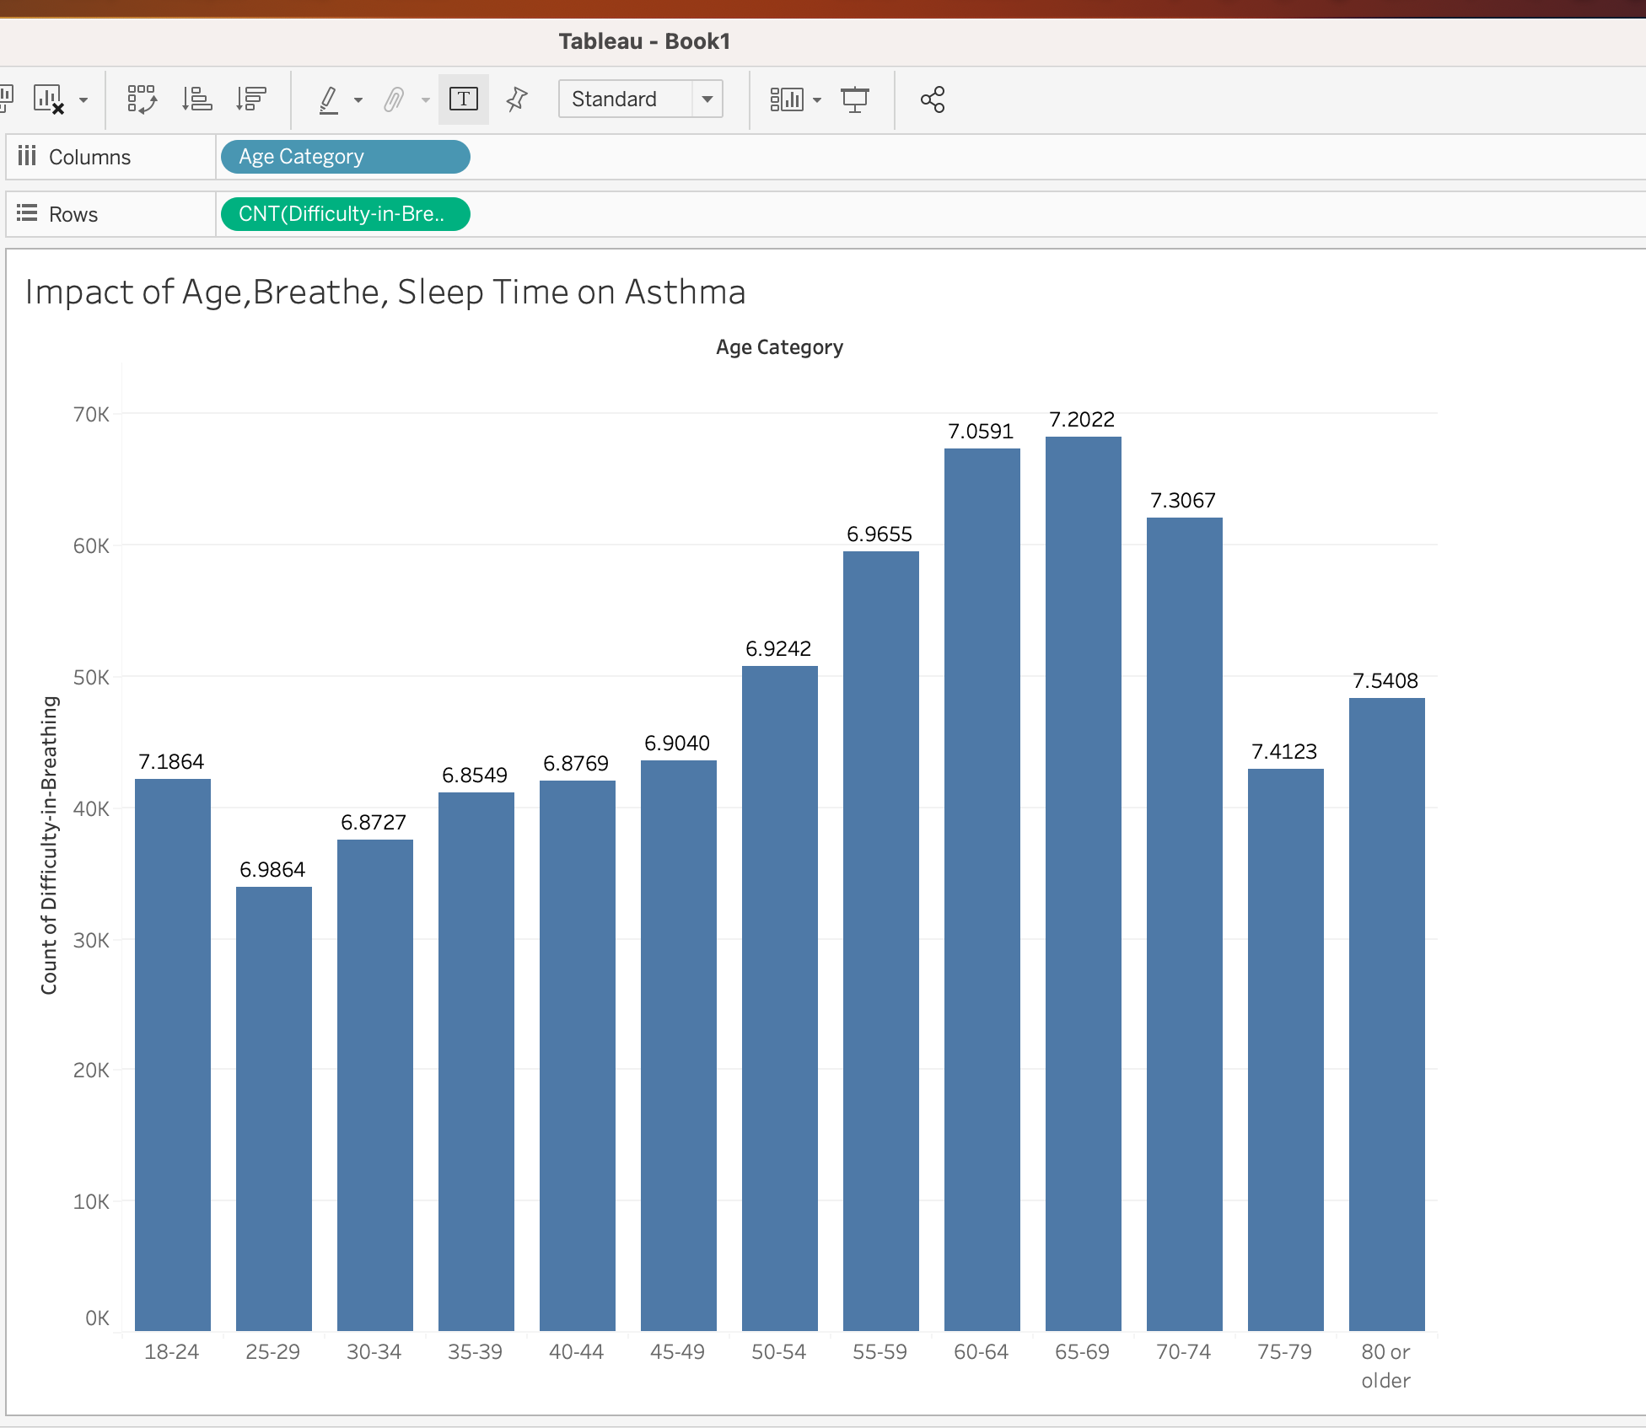
This slide shows the people that are prone to Asthma based on their age sleeping hours and the quality of their breathe.

Slide 8
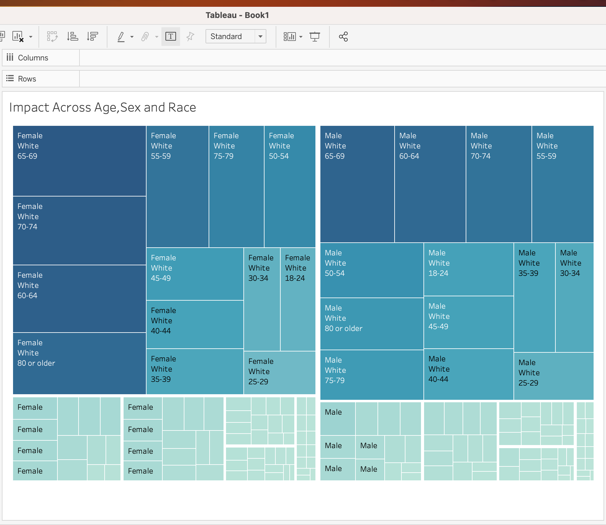
The slide below shows the prediction of
Asthma based on Race, Age and Sex of
Individual

Slide 9
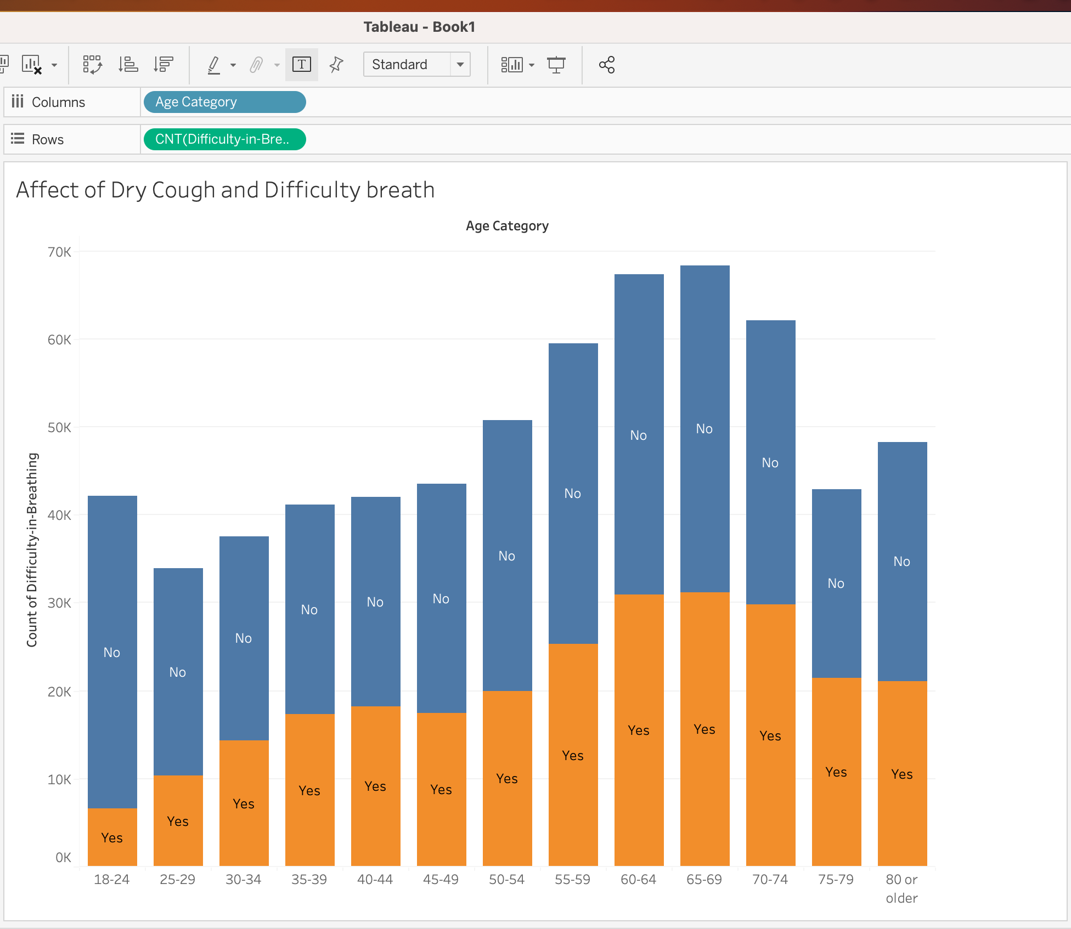
This graph represents the impact of Cough and the difficulty of breathing in early Diagnosis of Asthma.

Slide 10
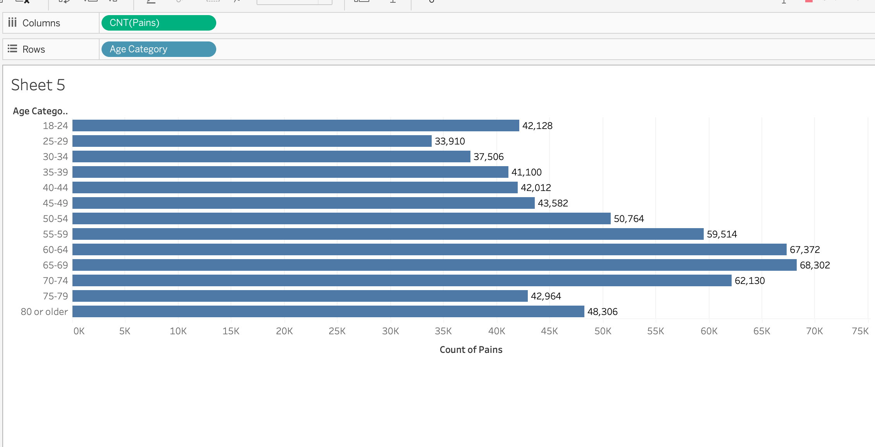

Slide 11
The above bar diagram shows the relation between the pain felt at various age group. The graph depicts
That the people between 60- 69 Age group are the most prone to Asthma as pain is higher in this
Individuals.

Slide 12
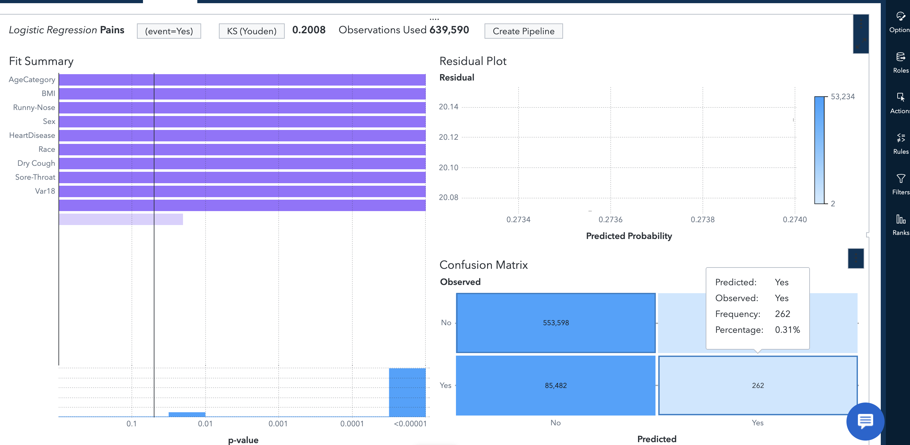
In this Logistic Regression, we see that the accurate percentage is only 0.31 because the model predicted with only 30% accuracy

Slide 13
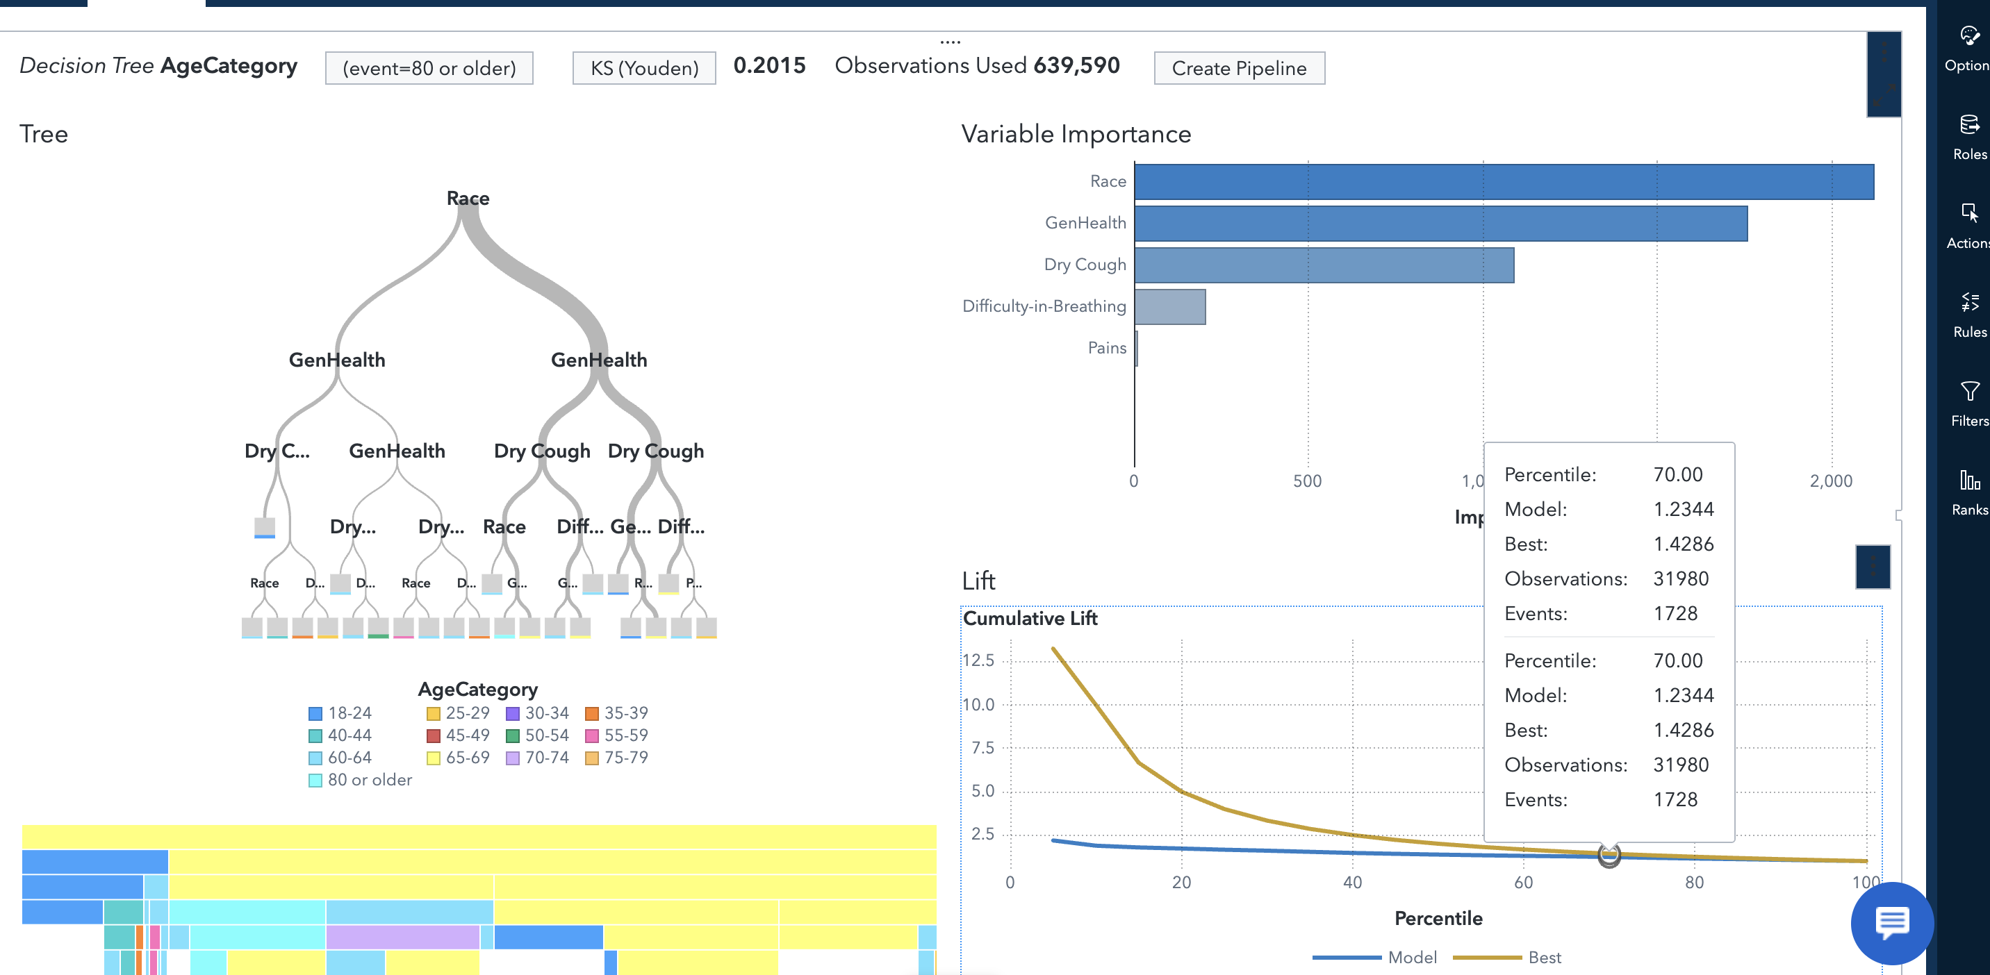
In the decision tree model The lift coincides with the model at 70% which means, both observed and expected were predicting the required values correctly from 70 percentile

Slide 14
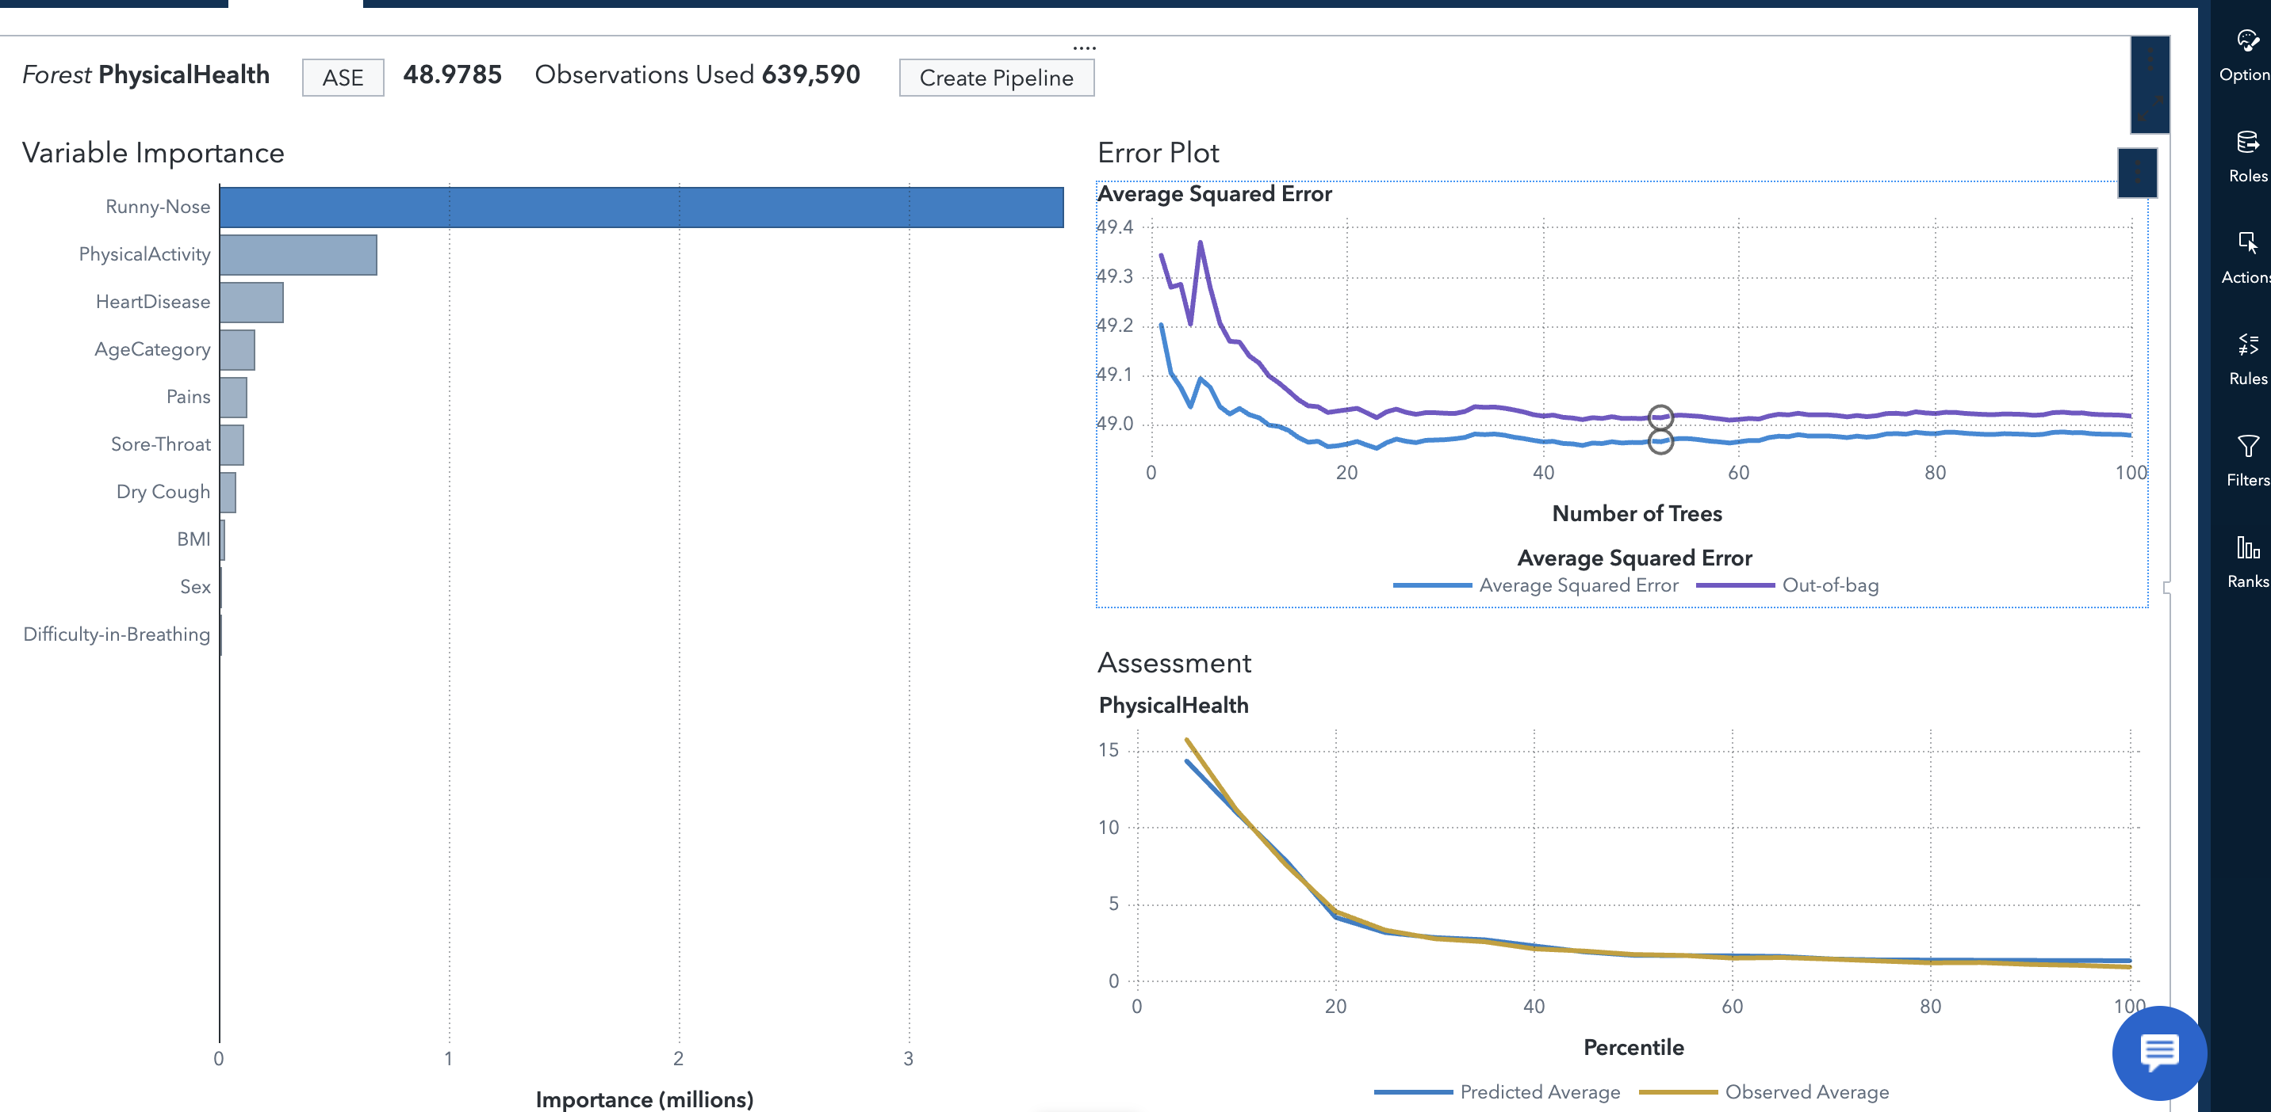
Using Random Forest Regression, we See that ‘Runny Nose’ is the most important variable in early detection of Asthma.

Slide 15

Lessons Learned
Higher the Age, More prone to Asthma irrespective
Of Race, Sex and other Factors
Soar Throat and Breathing has the major part in early prediction of Asthma, directly related.

Slide 16

Future Expansion
The project offers several avenues for extension. Future work should include more extensive data collection, potentially incorporating genetic factors and environmental variables.
Additionally , improving data quality and real-time monitoring systems can further enhance asthma management and patient care.

